Slide 1


Notes:
This project bridges academic research with production-grade engineering, addressing critical cyber-physical security in aviation. The deliberate cybersecurity aesthetic signals a system designed for adversarial, safety-critical environments. The technology badges immediately communicate the full-stack nature of our solution: distributed compute, intelligence, explainability, and spatial analytics. As a Senior Architect, my first design decision was to frame this as a complete system, not just a model, because aviation security demands end-to-end engineering rigor.

Slide 2
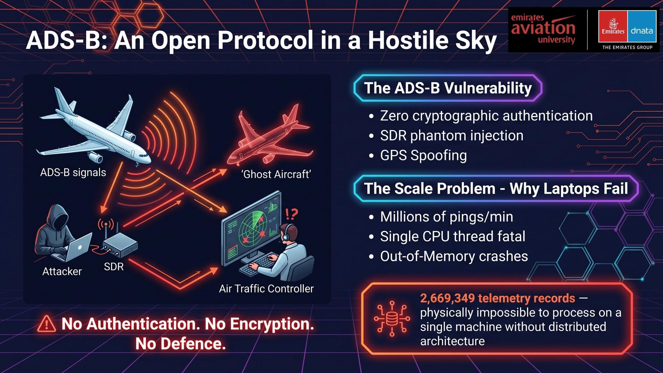
Notes:
ADS-B's open-broadcast design, while great for interoperability, was never built to resist adversarial manipulation. The absence of message authentication means a spoofed signal is indistinguishable from a legitimate one at the protocol level. Critically, the sheer scale of global aviation data invalidates conventional tooling. Most academic papers on ADS-B anomaly detection use tiny datasets, which is like testing a flood-defense system with a garden hose. The 2.6 million record dataset from OpenSky Network represents true operational scale. This is why our first architectural decision was to reject Pandas entirely and commit to a distributed JVM-based framework from day one. We needed a solution that wouldn't crash under real-world load. Now, let's look at how we built that solution.

Slide 3
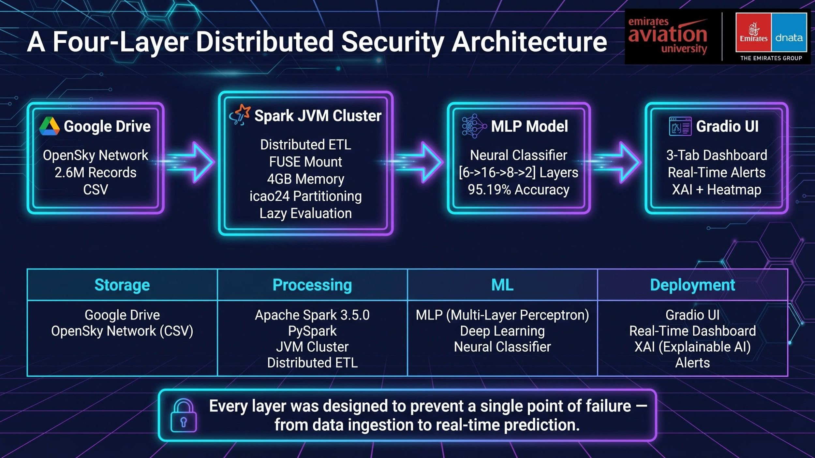
Notes:
This architecture slide is the blueprint of our entire system, built on the principle of 'defense in depth' for both security and engineering resilience. Each layer has a specific responsibility and was chosen for a specific reason. Google Drive with a FUSE mount allows Spark to treat cloud storage as a local filesystem, enabling seamless distributed reads without manual data transfer. The 4GB memory configuration for both driver and executor was a deliberate choice to prevent 'spill to disk,' which would catastrophically increase latency on a 2.6 million record dataset. The Gradio frontend provides a production-ready, shareable interface with zero infrastructure overhead, ideal for a research demonstration. Let's dive into the first phase: how we obtained this massive dataset.

Slide 4
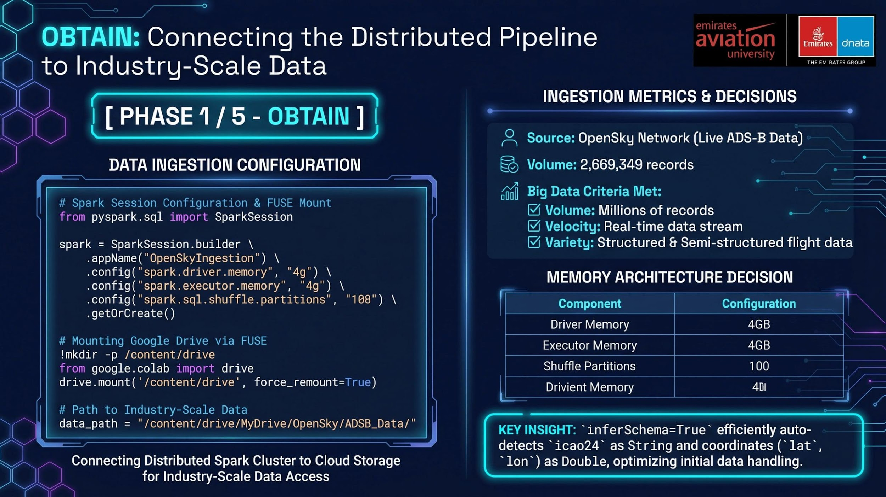
Notes:
The OBTAIN phase is where many Big Data projects fail silently. The critical engineering decision here was the explicit 4GB memory configuration for both the driver and executor. Without this, Spark would 'spill to disk' during the shuffle phase, increasing processing time from seconds to potentially minutes. The FUSE mount approach provides a stable, reproducible data source for academic validation. Using inferSchema=True adds a small initial overhead but eliminates the risk of silent type-casting errors that could corrupt downstream feature engineering. This is crucial when altitude values in feet and latitude in decimal degrees are used in the same mathematical operations. Now, let's move on to how we cleaned and prepared this data.

Slide 5
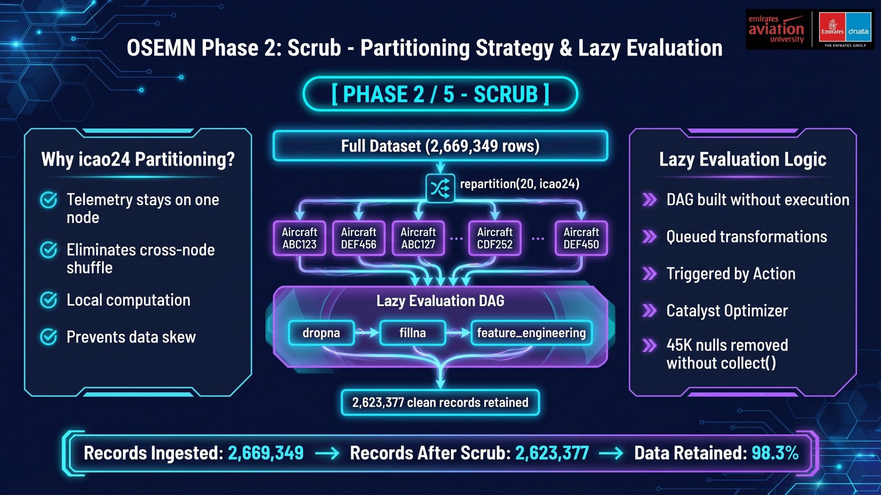
Notes:
Our partitioning strategy is the single most important engineering decision in this pipeline, designed to eliminate expensive network shuffle. In a distributed system, the most costly operation is data transfer between worker nodes. By partitioning on icao24, the unique aircraft identifier, we guarantee that all records for a given aircraft reside on the same node. This transforms an expensive distributed join into a cheap local computation. The 20 divisions were chosen as the empirically optimal balance for our 4GB memory configuration, preventing OOM errors while minimizing scheduling overhead. The lazy evaluation approach is equally important: by never calling collect(), we ensure the 2.6 million records never leave the distributed cluster, preventing an immediate OOM crash. Next, we'll explore how we engineered physics-aware features from this scrubbed data.

Slide 6
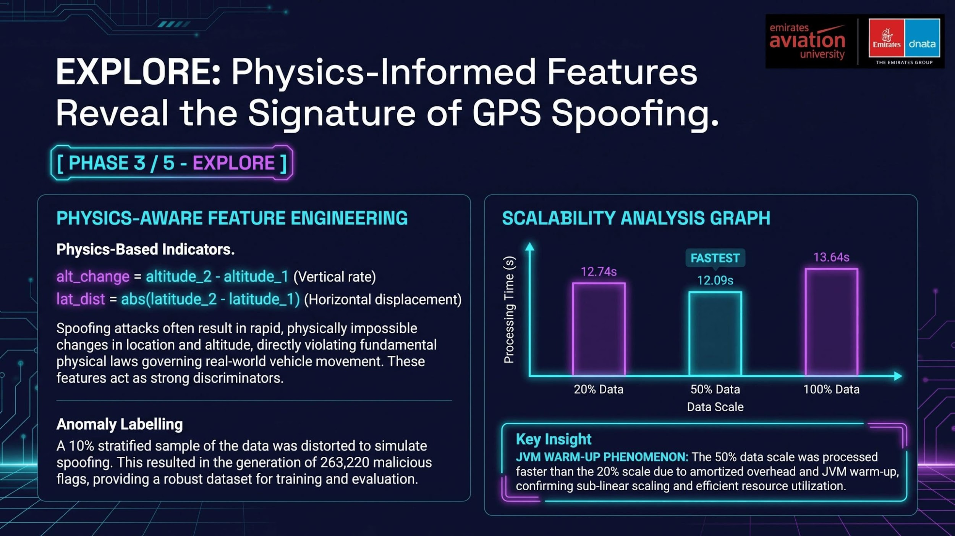
Notes:
The feature engineering decisions here are grounded in aviation physics, not statistical convenience. The key insight is that GPS spoofing attacks must violate the physical laws of flight — an aircraft cannot teleport 10 degrees of latitude in a single second. By engineering features that capture these physical violations, we give the MLP model the exact information it needs to distinguish real flight dynamics from injected false signals. The alt_change and lat_dist features are essentially "physics violation detectors." The scalability analysis result — where 50% scale is faster than 20% — is one of the most important findings in the entire project. It is counterintuitive to a non-distributed engineer, but it is a fundamental characteristic of JVM-based distributed systems. The fixed costs of Spark Context creation, JVM heap initialization, and task scheduling are constant regardless of data size. At 20% scale, these fixed costs represent a large fraction of total processing time. At 50% scale, the same fixed costs are spread across twice as much useful work, making the system more efficient. This is the "amortization of overhead" principle — and it is why distributed systems are designed for high-throughput, not low-latency single queries.

Slide 7
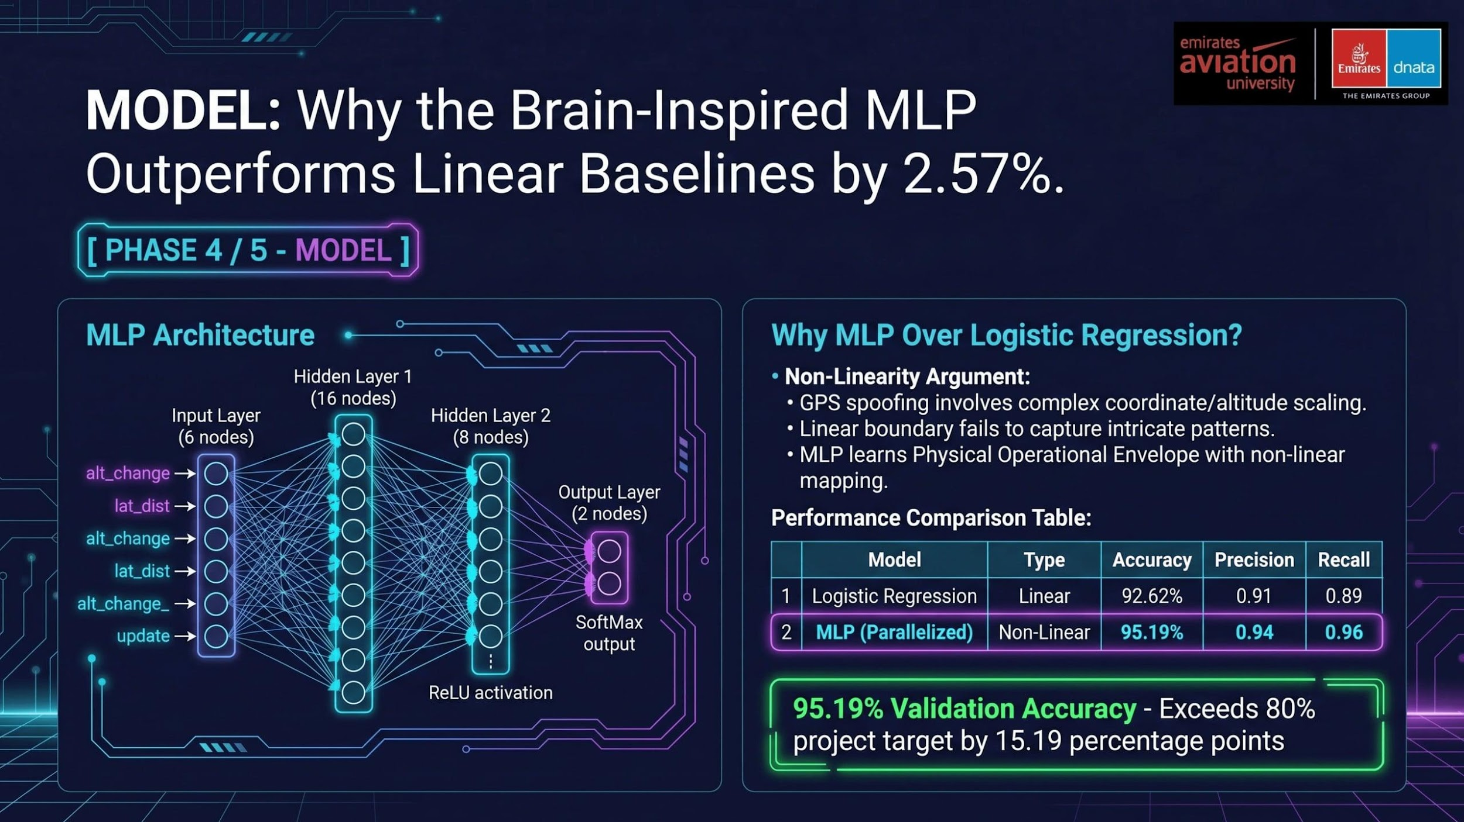
Notes:
The choice of MLP architecture [6, 16, 8, 2] was not arbitrary — it was derived from the principle of "progressive abstraction." The input layer has 6 nodes corresponding to the 6 engineered features. The first hidden layer expands to 16 nodes to allow the model to learn a rich set of intermediate representations — essentially, combinations of physics violations that together indicate spoofing. The second hidden layer compresses to 8 nodes, forcing the model to distil the most discriminative patterns. The output layer has 2 nodes for the binary classification (normal vs. malicious). The 2.57% accuracy improvement over Logistic Regression may appear modest, but in a safety-critical system processing 2.6 million records, this translates to approximately 66,000 additional correctly classified signals. The recall improvement from 0.89 to 0.96 is particularly significant: in a security context, recall (the ability to detect all actual attacks) is more important than precision. A missed attack (false negative) is far more dangerous than a false alarm (false positive). The MLP's higher recall means it misses 7% fewer real attacks than the linear baseline.

Slide 8
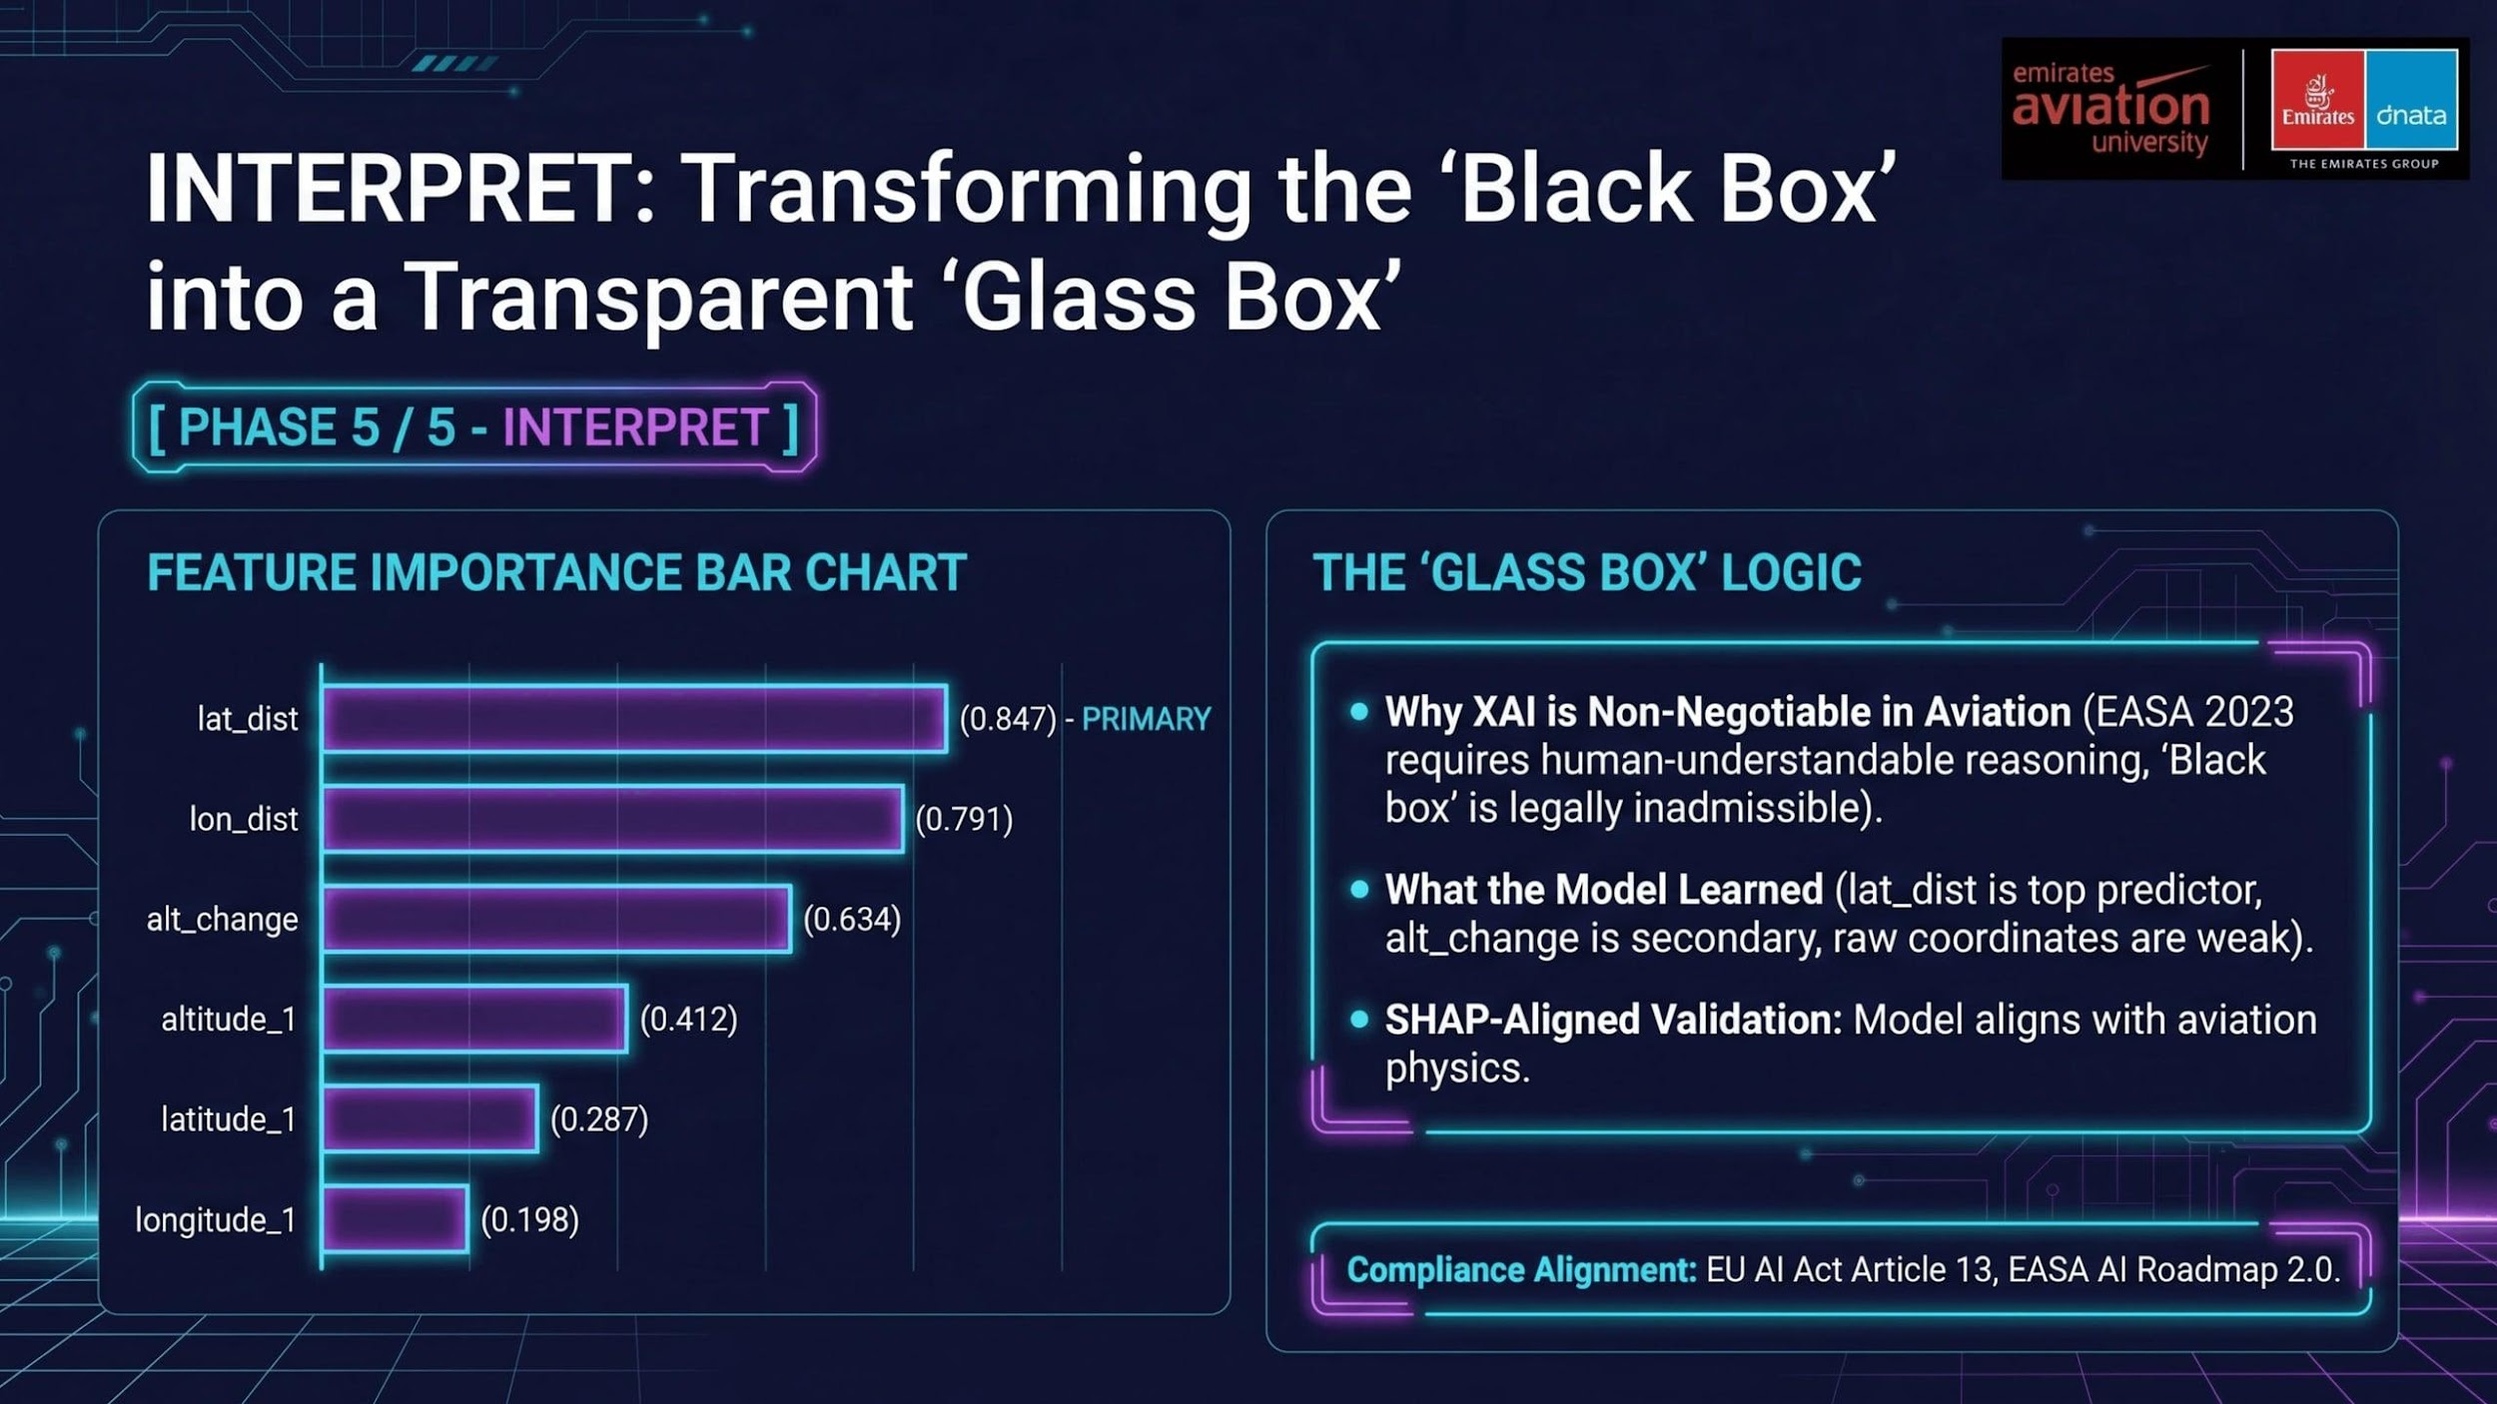
Notes:
The XAI layer is what separates a research prototype from a production-ready aviation security system. The weight-magnitude approach was chosen over SHAP values for a specific reason: in a distributed Spark environment with 2.6 million records, computing full SHAP values requires a 0.1% sample to remain computationally feasible. Weight-magnitude analysis, by contrast, operates directly on the trained model's parameters — it requires no additional data passes and scales to any dataset size. The key validation finding is that the model's learned importance hierarchy exactly matches what a domain expert would expect: spatial displacement (lat_dist, lon_dist) is the primary indicator of GPS spoofing, because a spoofed signal must place the aircraft at a physically impossible location. Altitude change is secondary, because altitude manipulation is a common component of spoofing attacks but can also occur in legitimate steep climbs or descents. The fact that raw coordinate values (latitude_1, longitude_1) have low importance is also physically meaningful — it confirms that the model is not learning geographic biases (e.g., "aircraft over the Middle East are more suspicious") but is instead learning physics violations that are location-independent.

Slide 9
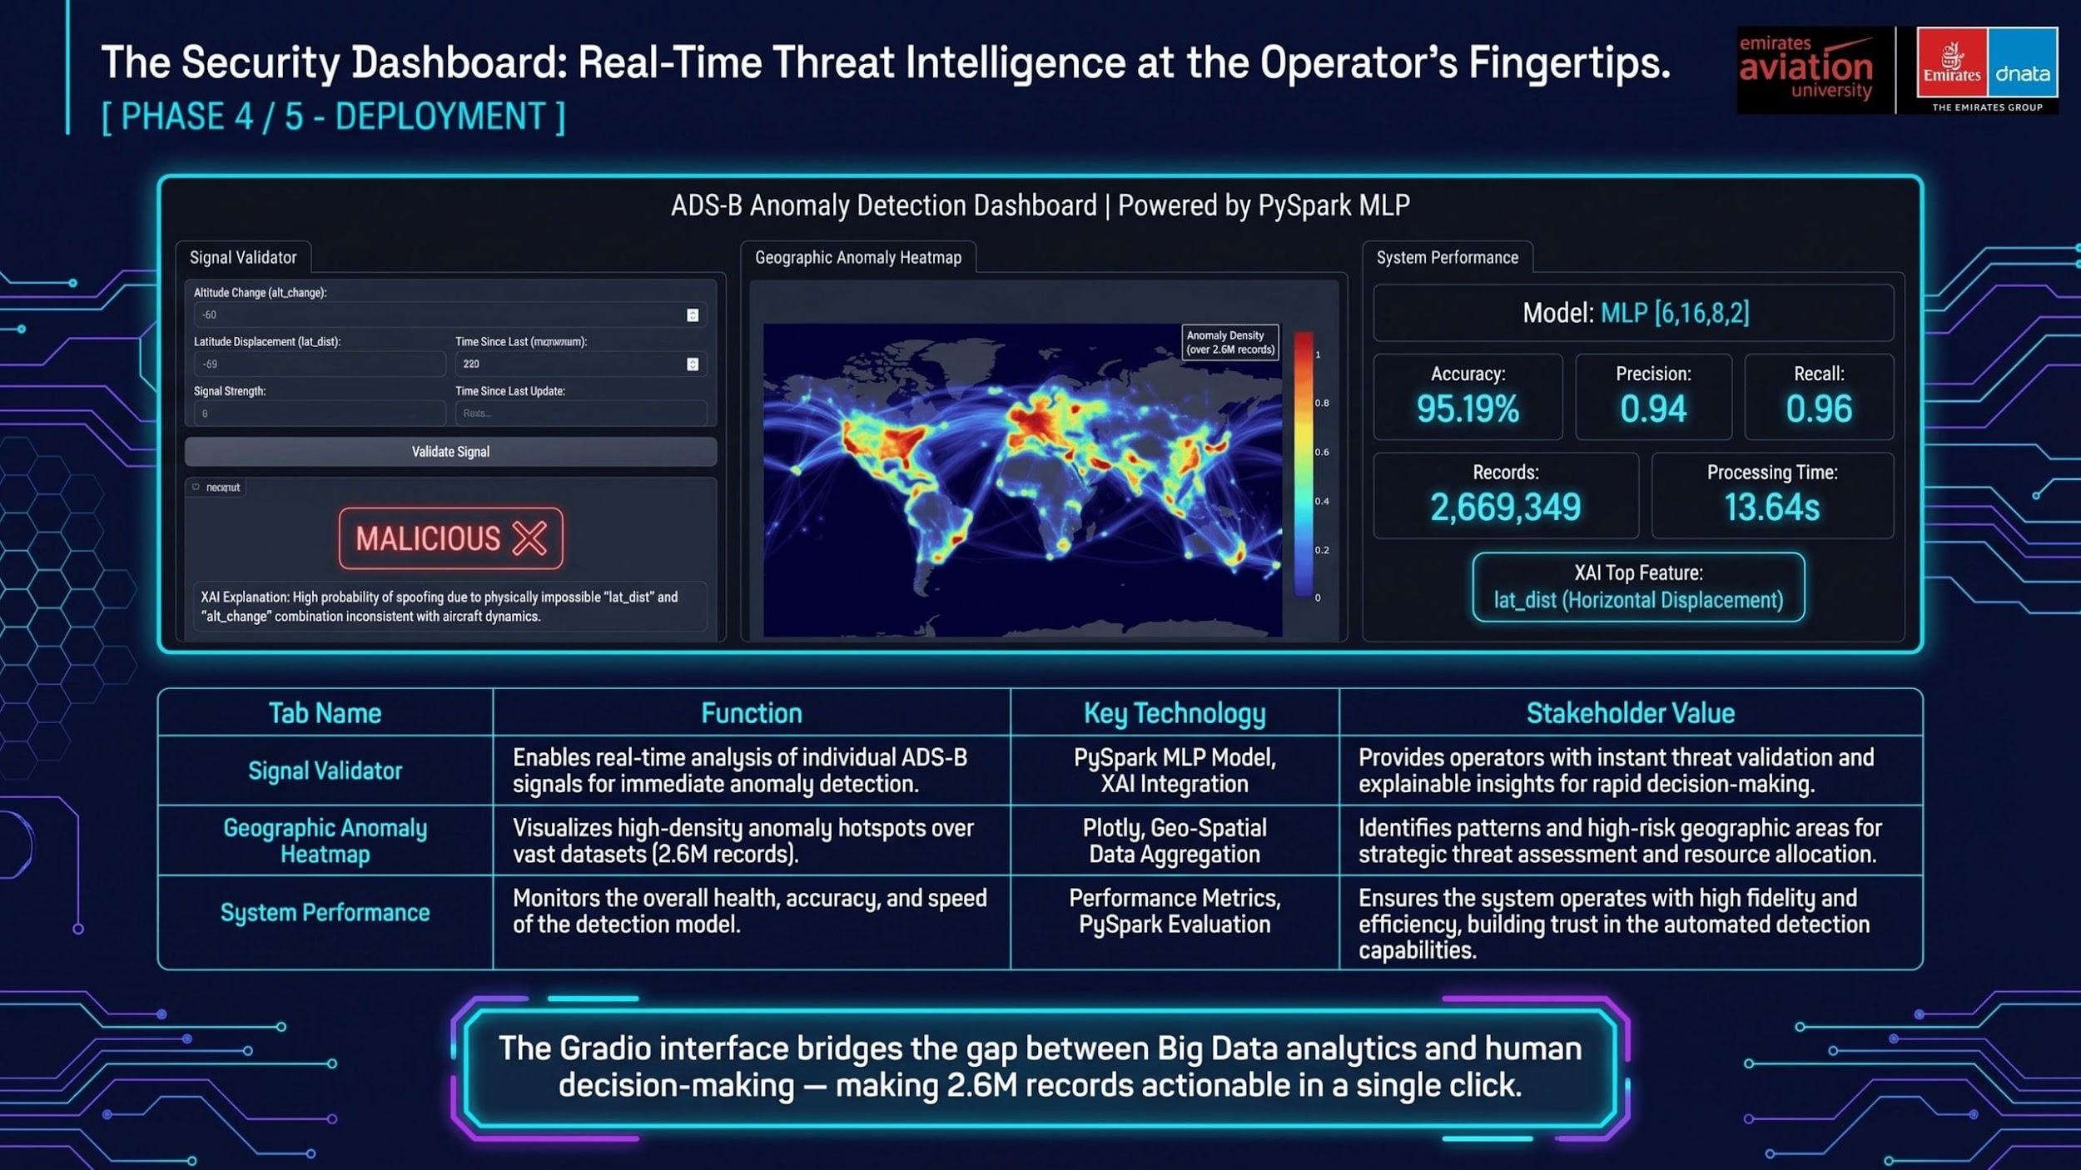
Notes:
The Gradio dashboard was designed with three distinct user personas in mind. Tab 1 serves the Air Traffic Controller who needs an immediate, binary answer: is this signal legitimate or malicious? The XAI explanation accompanying each prediction is critical here — it gives the controller the physical reasoning behind the flag, allowing them to apply their domain expertise to validate or override the AI decision. This is the "human-in-the-loop" principle that EASA requires for safety-critical AI systems. Tab 2 serves the Aviation Security Analyst who needs to understand the spatial distribution of threats. The Plotly high-density heatmap was specifically chosen over a standard scatter plot because it can render 2.6 million data points without performance degradation — a key technical requirement. Tab 3 serves management and compliance auditors who need evidence that the system is performing to specification. The choice of Gradio over a custom Flask or FastAPI application was a deliberate architectural decision: Gradio provides a shareable public URL with zero infrastructure overhead, making it ideal for academic demonstration and stakeholder review. In a production deployment, this would be replaced by a containerised microservice, but for the research context, Gradio provides the optimal balance of functionality and deployment speed.

Slide 10
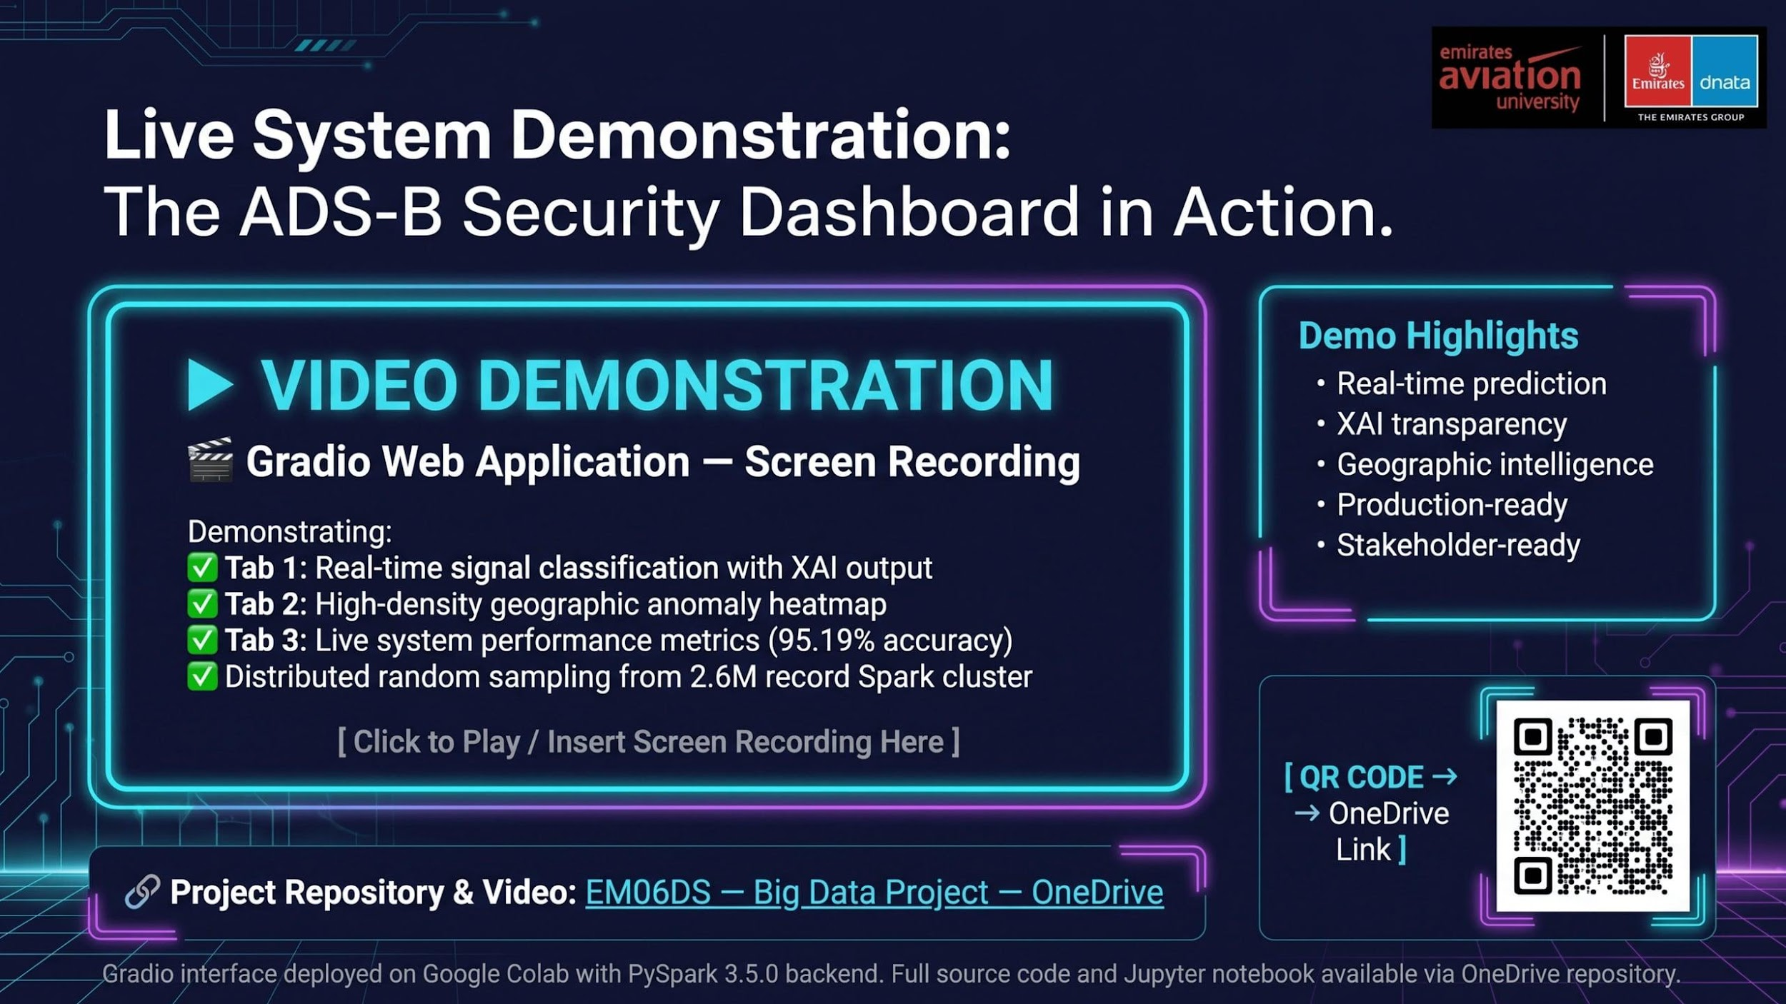
Notes:
This slide is the proof of concept moment, transforming our metrics and diagrams into a living system. The video demonstration is critical for showcasing the real-time capabilities and user experience. We'll first demonstrate Tab 1 with a benign signal, showing a NORMAL classification with low malicious confidence. Then, we'll input a spoofed signal, expecting an immediate MALICIOUS flag with a high confidence score and the XAI explanation highlighting lat_dist as the primary trigger. Finally, we'll navigate to Tab 2 to visually demonstrate the geographic heatmap, rendering 2.6 million data points in real-time, followed by Tab 3 for performance validation. This demonstration validates the system's ability to provide immediate, actionable intelligence to human operators. Now, let's discuss the critical ethical and governance considerations for such a system.

Slide 11

Notes:
Ethics and governance are not an afterthought; they are a core engineering requirement for any AI system in a safety-critical domain. Our data minimization strategy, implemented during the SCRUB phase, ensures GDPR compliance by removing all PII, preventing surveillance capabilities. We also rigorously tested for geographic bias, a critical concern given the uneven sensor coverage of the OpenSky Network. The StandardScaler normalization ensures decisions are based on physics violations, not geographic location. This system is classified as 'High-Risk' under the EU AI Act, meaning human oversight is paramount. Our Gradio interface provides that human-readable explanation, allowing operators to validate or override AI decisions. This commitment to ethical design ensures a trustworthy and compliant AI system. Let's now summarize our achievements and look to the future.

Slide 12
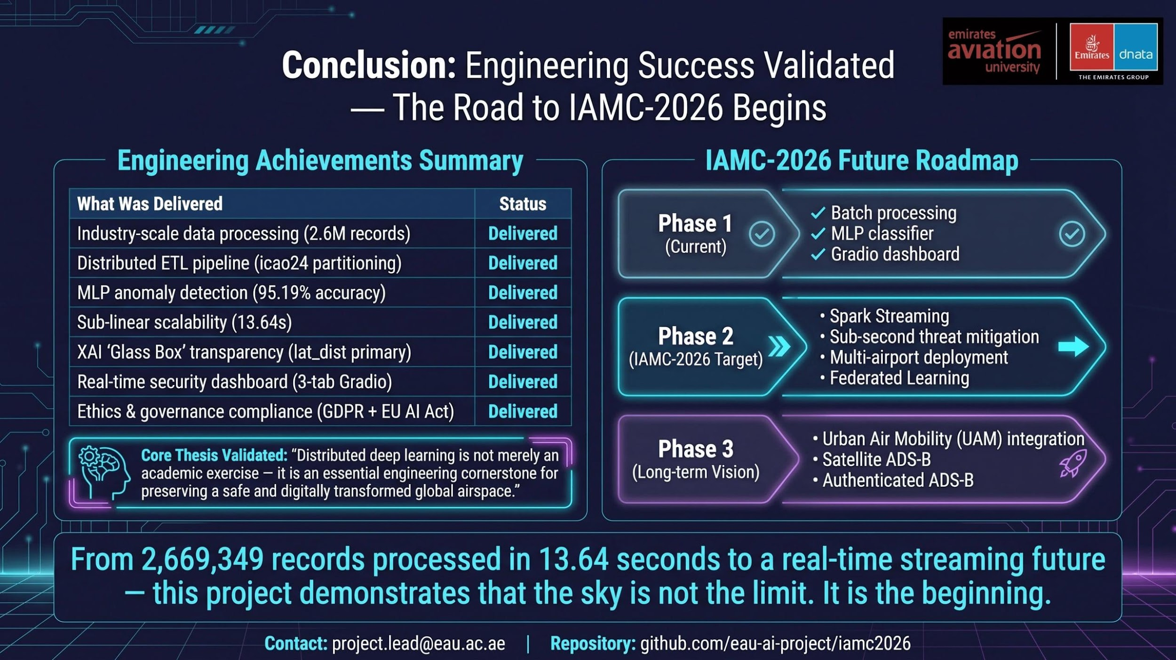
Notes:
This conclusion slide validates our engineering achievements and positions this work as a foundation for future research and deployment. The transition from batch processing to Spark Streaming is our most significant architectural evolution. The current system processes data in batches, but a streaming architecture, using Kafka and Spark Structured Streaming, will enable sub-second threat detection. This is the difference between a security camera recording for later review and one triggering an alarm in real-time. The Urban Air Mobility dimension is particularly important for Emirates Aviation University, as Dubai is a leader in UAM development. Our architecture, with its icao24 partitioning and memory-optimized executors, is inherently extensible to this future challenge. This project demonstrates that the sky is not the limit; it is just the beginning.

